Slide 1
W03 – spark architecture & core components
The hoang

Slide 2
Learning Objectives – w03
Understand the core architecture of Apache Spark.
Learn about Resilient Distributed Datasets (RDDs) and their role in Spark.
Explore DataFrames, Datasets and the benefits they offer over RDDs.
Discover how to use Spark SQL to query structured data.
Environment setup, hands-on activities.

Slide 3
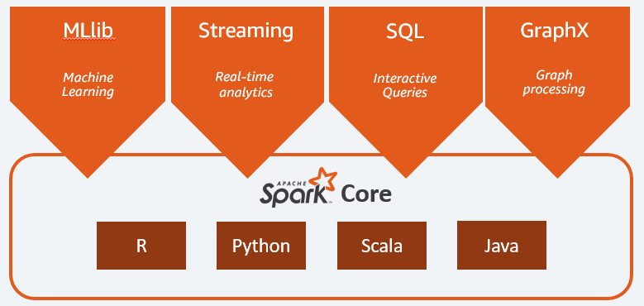
Apache Spark – Introduction
Overview
Apache Spark is an open-source distributed computing system that provides an interface for programming entire clusters with implicit data parallelism and fault tolerance.
Core components:
Spark Core
Spark SQL
Spark Streaming
ML
Graph

Slide 4
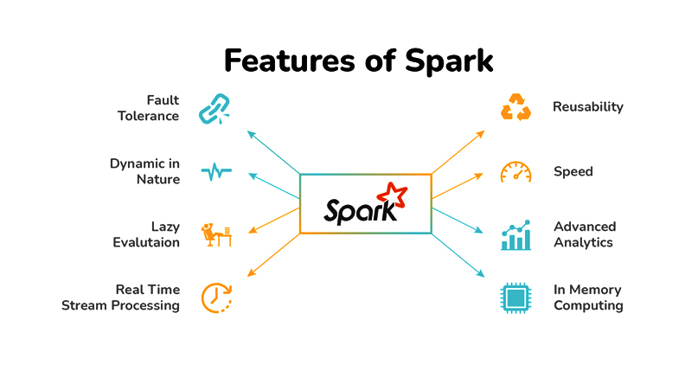
Apache Spark – Introduction
Key Features
Fault tolerance: automatically recover from node failures
Scalability: can handle massive workloads by scaling to thousands of machines, process terabytes of data
Speed: In-memory (RAM). 100x faster HADOOP
Muti-language support: Java, Scala, Python, and R.
Lazy evaluation
Unified Engine: Single runtime & platform for different data processing tasks: batch; streaming; interactive queries; ML; Graph
Integration: can integrates with other big data technologies like Hadoop, Kafka

Slide 5
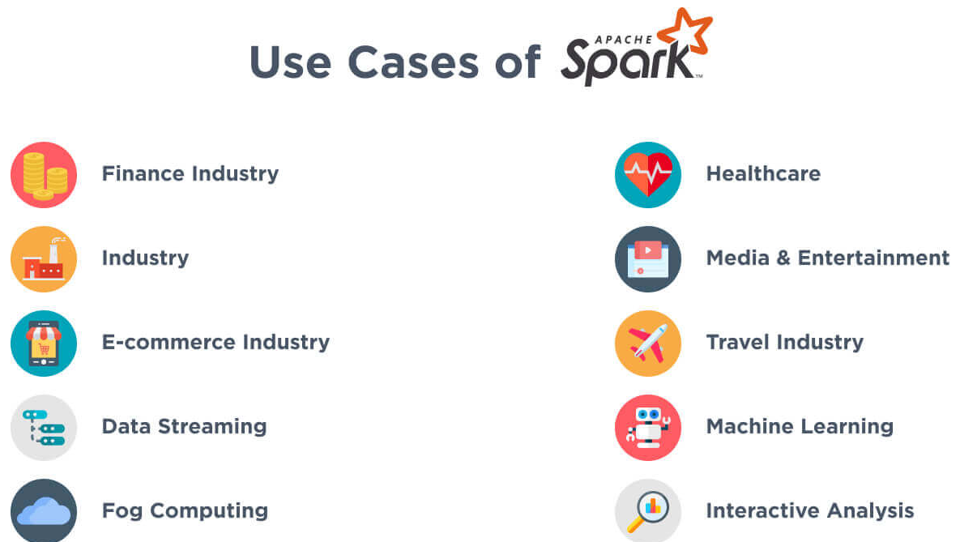
Apache Spark – Introduction
Use Cases
Real-time data processing and streaming analytics
Large-scale data transformation. ETL (Extract, Transform, Load) pipelines
Machine learning & Advanced Analytics e.g. classification, regression, clustering, recommendation systems …
Graph processing: Social network analysis, recommendation engine, fraud detection

Slide 6
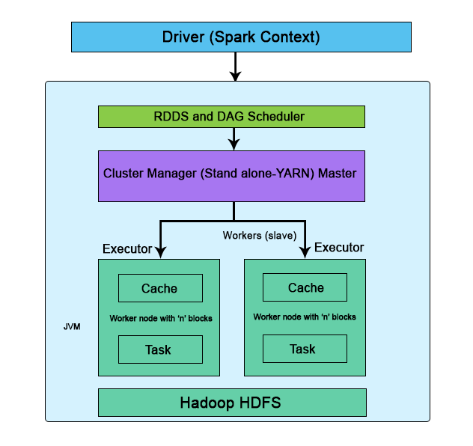
Spark Architecture Overview - Core Components
Driver: The process that orchestrates the execution of the Spark application. It converts the user's code into a DAG (Directed Acyclic Graph) of tasks.
Executors: The distributed worker processes that run the tasks assigned by the driver. Each executor has its own memory and storage.
Cluster Manager: This is the component responsible for managing and allocating resources across the cluster. Examples include YARN, Mesos, and Kubernetes.

Slide 7
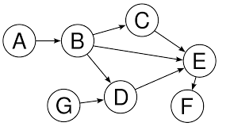
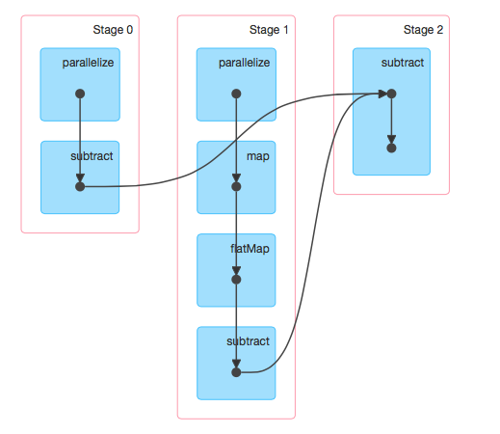
Spark Architecture Overview - DAG
A directed acyclic graph (DAG) is a conceptual representation of a series of activities. The order of the activities is depicted by a graph, which is visually presented as a set of circles, each representing an activity, some of which are connected by lines, representing the flow from one activity to another.
In Apache Spark, DAG is a fundamental concept used by Spark's execution engine to represent and optimize the flow of operations in a data processing job.

Slide 8
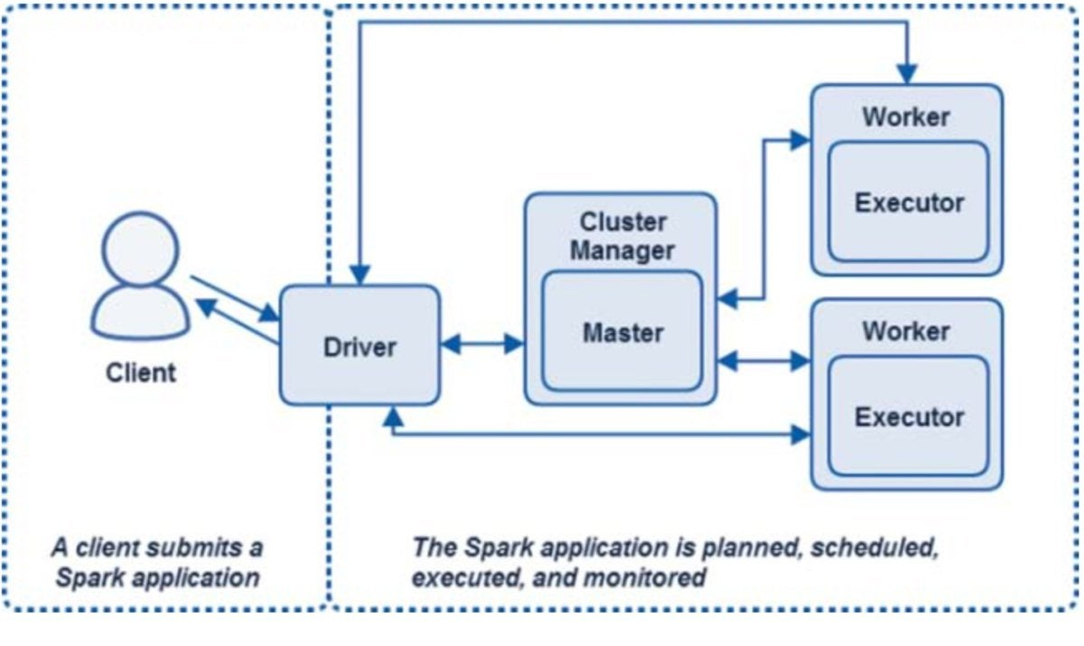
Spark Architecture Overview - Execution Flow
Job Submission: The user submits a Spark application.
DAG Creation: The driver converts the operations into a DAG.
Task Scheduling: The DAG is broken down into tasks, which are scheduled on executors.
Task Execution: Executors execute the tasks and return the results to the driver.

Slide 9
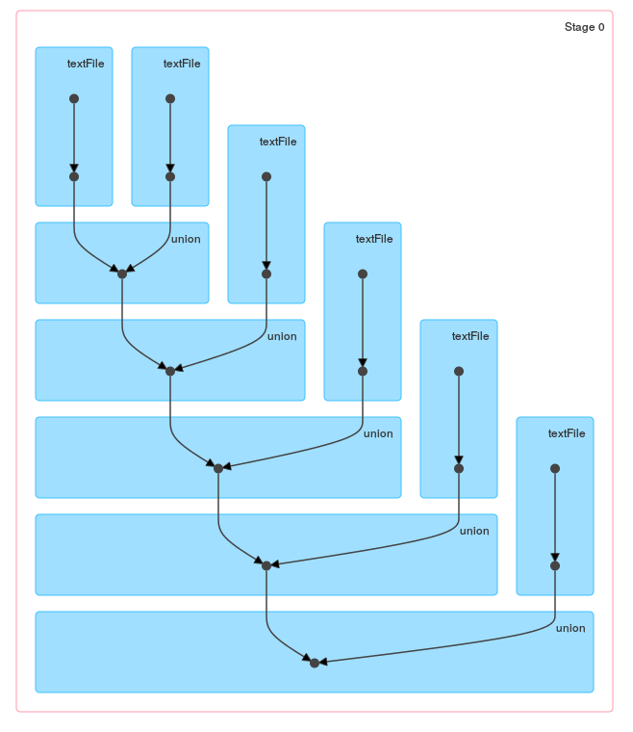
Spark Architecture Overview - Fault Tolerance
Spark automatically retries failed tasks and uses lineage information to recompute lost data.

Slide 10
Resilient Distributed Datasets (RDDs)
The fundamental data structure in Spark.
An immutable collection of elements distributed across multiple nodes.
Supports transformations (operations that create new RDDs) and actions (operations that compute and return results).
There are 2 types of transformation: wide transformation and narrow transformation
Narrow: each input partition contributes to only one output partition; do not shuffle; executed in single stage.
Wide: one input partition can contribute to multiple output partitions; data is shuffled, resulting in a stage boundary.
RDDs maintain a lineage graph, which records the sequence of transformations that created the RDD.
Lazy Evaluation: Transformations on RDDs are not executed immediately. They are only executed when an action is called.
Examples of transformations
Narrow: map, filter, flatMap, union, coalesce, …
Wide: groupByKey, reduceByKey, join, cogroup, distinct, …
Examples of actions: collect, count, first(n), take(n), reduce.

Slide 11
Resilient Distributed Datasets (RDDs)

Slide 12
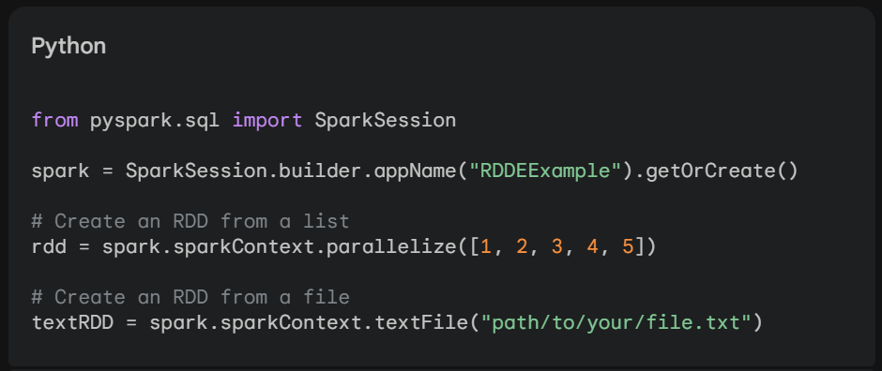
Resilient Distributed Datasets (RDDs) – Examples
RDD Creation: An RDD can be created from a list of elements, a file, or another RDD.
Results:
rdd = [1, 2 , 3, 4, 5]
The textRDD variable will contain an RDD where each element is a line from the specified file.

Slide 13
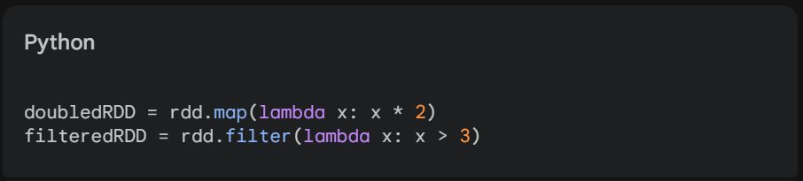
Resilient Distributed Datasets (RDDs) - Examples
RDD Transformations: Create new RDDs based on existing RDDs.
Results:
doubledRDD: [2, 4, 6, 8, 10]
filteredRDD: [4, 5]

Slide 14
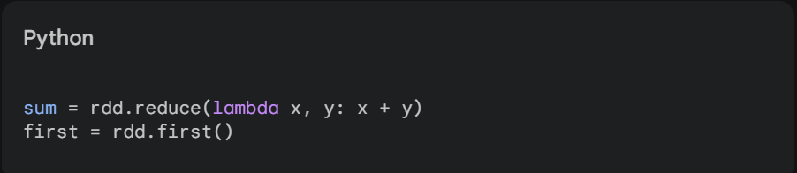
Resilient Distributed Datasets (RDDs) - Examples
RDD Actions: Trigger the execution of transformations and return a result.
Results:
sum: 15
first: 1

Slide 15
Resilient Distributed Datasets (RDDs) – Use cases
Low-level operations: RDDs provide more granular control over data processing and can be useful for complex transformations.
Custom data structures: If you need to work with custom data structures that don't fit well into DataFrames or Datasets, RDDs can be a good option.
Legacy code: If you have existing Spark code that uses RDDs, you may need to continue using them for compatibility reasons.
However, in most cases, DataFrames and Datasets are preferred due to their higher-level API, performance optimizations, and integration with Spark SQL.

Slide 16
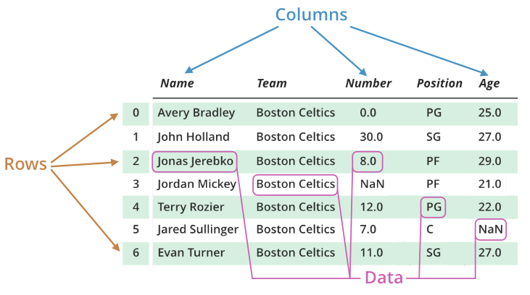
DataFrames – definition
DataFrames are distributed collections of data organized into named columns, similar to a table in a relational database or a DataFrame in Python's Pandas library.
A higher-level abstraction built on top of RDDs.
Represent structured data with named columns and data types.

Slide 17
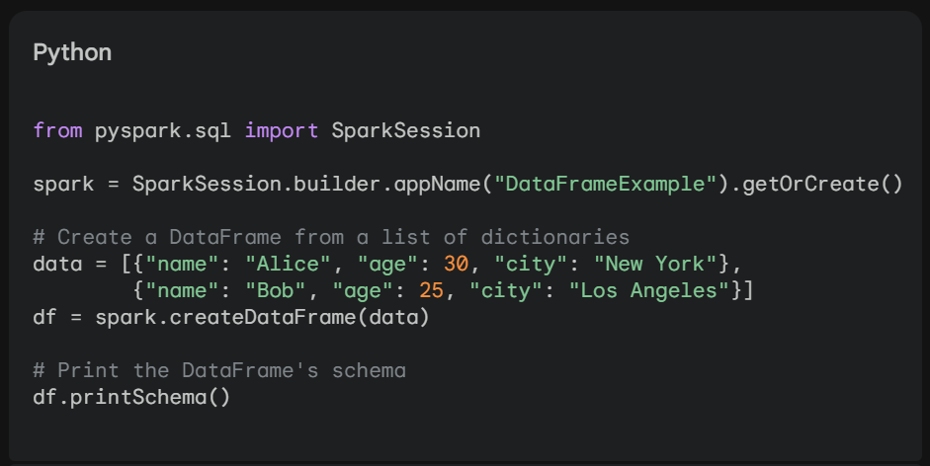
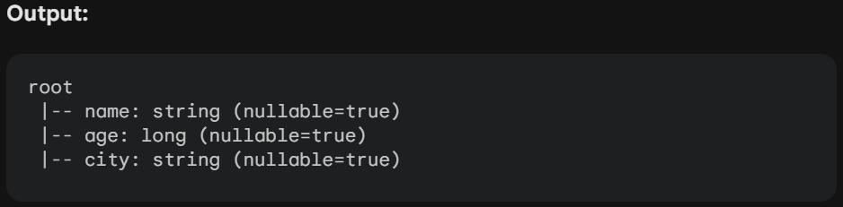
DataFrames – key features
Schema: defined schema, i.e. column names and data types
=> easier to work with structured data

Slide 18
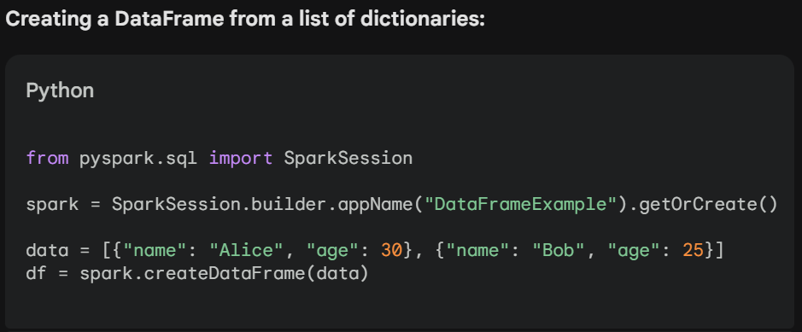
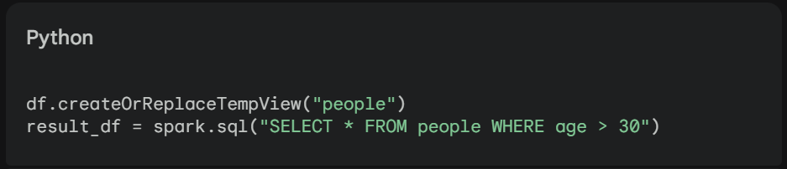
DataFrames – key features
SQL-like interface: can be manipulated using SQL-like syntax. (DML)
Integration with Spark SQL: DataFrames are tightly integrated with Spark SQL, allowing for efficient query processing and optimization.

Slide 19
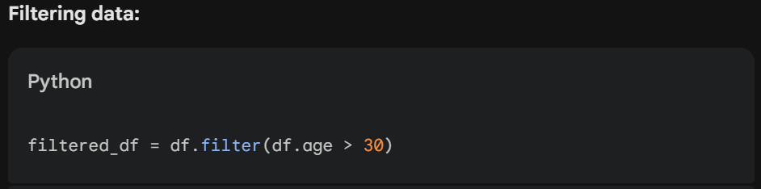
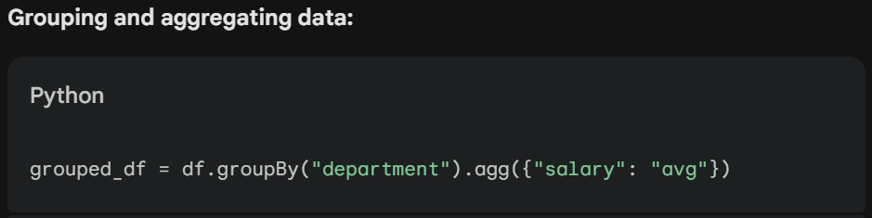
DataFrames – key features
Domain-specific language (DSL): provides functions that are specifically designed for data analysis tasks, such as filtering, grouping, joining, and aggregating data.

Slide 20
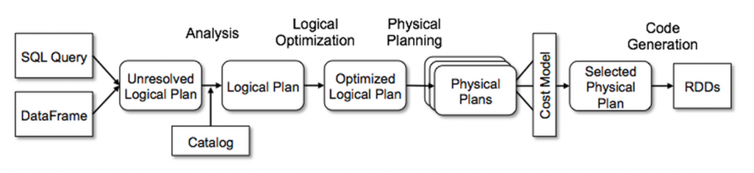
FYI - Versioning in OSS: Major.Minor.Bugfixes
DataFrames - key features
Catalyst optimizer: automatically optimize queries and improve performance.
Unresolved Logical Plan - Contains unresolved references.
Analyzed Logical Plan - All references are resolved (usually by looking into the data catalog)
Optimized Logical Plan - Optimized plan by the Catalyst optimizer for better performance, such as pushdown filters, combining operations, selecting efficient execution plans
Physical plans - execution plans for the query, including the sequence of operations and the specific algorithms to be used.
Cost model - A model used to estimate the cost of different physical plans based on number of rows, data distribution, and available resources.
AQE (* from Spark version 3): A feature that allows Spark to dynamically adjust the execution plan based on runtime conditions e.g. data distribution, resource availability ..
Selected physical plan - The physical plan chosen by the Catalyst optimizer to execute the query based on outputs from the Cost model and AQE.
Code generation - The process of generating optimized machine code from the selected physical plan.

Slide 21
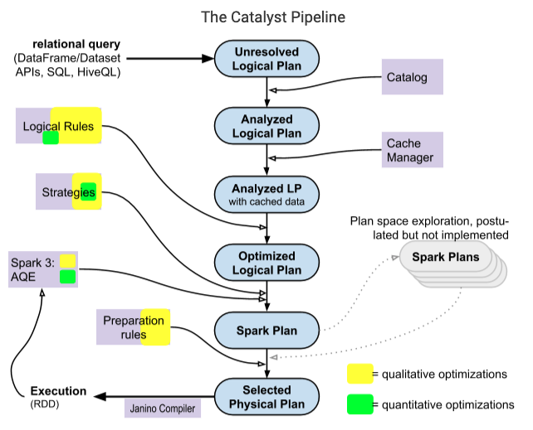
DataFrames - key features
Performance: more performant than RDDs for certain operations, especially when working with structured data thanks to the Catalyst optimization.

Slide 22
DataFrames – Use cases
DataFrames in Apache Spark are well-suited for a wide range of use cases involving structured and semi-structured data
Data Analysis and Exploration
Machine Learning
Data Warehousing and Business Intelligence
Real-time Data Processing
Graph processing
Natural language processing (NLP)
Recommendation systems
…

Slide 23

DataFrames – example / classroom practice
Loading a CSV file into a DataFrame and performing operations, such as filtering and aggregating data.

Slide 24
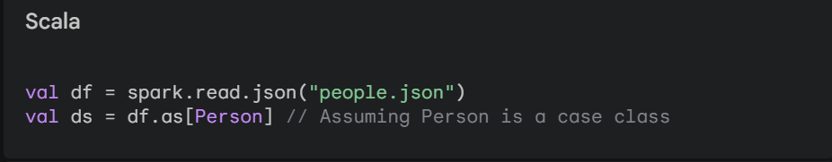
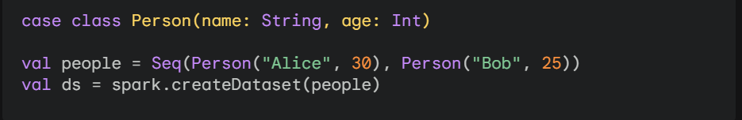
Dataset – definition
Datasets in Spark are a typed version of DataFrames. They provide a more concise and expressive API for working with structured data, and they enforce type safety to prevent errors caused by incorrect data types.
Note: Since Dataset is strong typed, it’s not available in untyped languages such as Python (Pyspark). In Python you can you typespark instead.

Slide 25
Dataset – Key features
Type safety: Datasets enforce type safety, ensuring that data is of the correct type.
Concise API: Datasets provide a more concise API compared to RDDs, making it easier to work with structured data.
Integration with Spark SQL: Datasets are tightly integrated with Spark SQL, allowing for efficient query processing and optimization.

Slide 26
Dataset – Use cases
Working with complex data structures: When dealing with complex data structures that require strong type safety, Datasets can help prevent errors and improve code readability.
Enforcing data quality: Datasets can be used to enforce data quality rules and prevent invalid data from entering your system.
Improving performance: Datasets can sometimes offer better performance than DataFrames, especially when working with complex data structures.

Slide 27
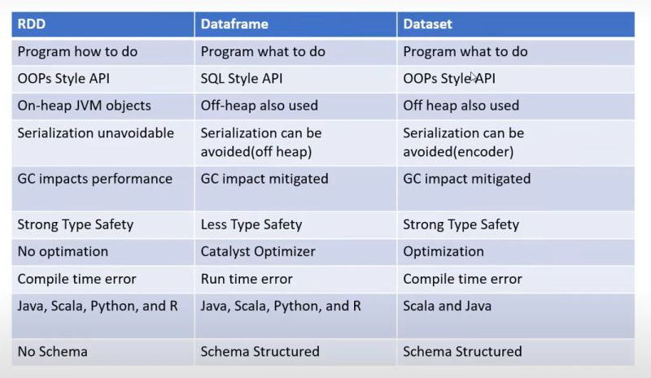
RDD vs. DataFrame vs. Dataset – In summary
RDDs are the fundamental building blocks of Spark, providing a low-level API for working with distributed data.
DataFrames are a higher-level abstraction that provide a SQL-like interface for working with structured data.
Datasets are a typed version of DataFrames, offering additional type safety and expressiveness.

Slide 28

RDD vs. DataFrame vs. Dataset – Key take aways
DataFrames and Datasets are built on top of RDDs.
DataFrames and Datasets provide a more convenient and efficient way to work with structured data compared to RDDs.
Datasets offer additional type safety compared to DataFrames.

Slide 29
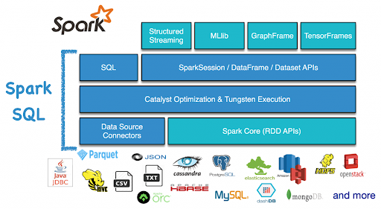
Spark SQL – Introduction
Spark SQL is a module for structured data processing. It provides an API for querying data using SQL, along with the ability to mix SQL queries with Spark's RDD and DataFrame APIs.

Slide 30
Spark SQL – Key features
SQL Interface: Allows you to query and manipulate data using familiar SQL syntax.
DataFrames and Datasets: Provides DataFrame and Dataset abstractions for structured data, offering columnar storage and rich APIs.
Integration with Spark Core: Leverages the same distributed processing engine, ensuring scalability and performance.
Optimized Query Execution: Employs advanced query optimization techniques for efficient data processing.
Built-in functions: Math, statistics, …
UDFs and UDAFs: Supports user-defined functions (UDFs) and user-defined aggregate functions (UDAFs) to extend functionality. -> use with cares

Slide 31
Spark SQL – Example
Scenario
Analyzing a DataFrame of sales data using SQL queries. (data can be downloaded from Kaggle, …)
Steps
Register DataFrame as Table: df.createOrReplaceTempView("sales")
Run SQL Query: result = spark.sql("SELECT region, SUM(sales) AS total_sales FROM sales GROUP BY region HAVING total_sales > 10000")
Show Results: result.show()

Slide 32
Spark SQL – Example
Explanation
The DataFrame is registered as a temporary SQL table.
A SQL query is run to group sales by region and filter regions with total sales greater than 10,000.
The results are displayed using the show() action.
Benefits
Familiar SQL syntax for querying large datasets.
Seamless integration with other Spark components.

Slide 33
Spark SQL – Benefits
Simplified Data Processing: SQL syntax is more intuitive for many users, making data processing tasks easier.
Scalability: Handles large datasets efficiently due to its distributed processing capabilities.
Performance: Optimized query execution ensures fast data processing.
Integration with Other Spark Components: Works seamlessly with other Spark modules like Spark Streaming and MLlib.
Rich Functionality: Provides a wide range of SQL operations and APIs for data manipulation – built-in functions

Slide 34
Spark SQL – Online materials
Official document
Spark SQL Built-in Functions

Slide 35
Practices & prepare for the next sessions
Setup Pyspark environment – must be ready before tutorial sessions
Setup for Windows
Setup for MacOS (Linux)
Advanced: Setup Pyspark Notebook using Docker
Advanced: Setup a Spark cluster using Docker
Launch simple interactive Pyspark-shell
Starting point: Get SparkSession
Creating DataFrames
DataFrame Operations
Running SQL Queries
Global Temporary View
Interoperating with RDDs
Scalar Functions
Aggregate Functions
UDFs – User Defined Functions
UDAFs - User Defined Aggregation Functions
View & Understand SparkUI

